Slide 1
EMPIRICAL EVALUATION OF HEART ATTACK DETECTION
Sai Nikhil Reddy vatti -700743280
Vamshi Ponugoti-700742855
Rahul Sagar mykala- 700735146

Slide 2
Role/Responsibilities and Contribution in project
Description: Gathering datasets and choosing the most relevant dataset from the internet and implementing various visualisation techniques for the dataset.
Implement Naïve Bayes classifier for the given dataset and find the accuracy, and classification report.
Person Assigned: Rahul sagar myakala
Description: Handle missing data by missing replacing the missing data with mean using simple imputer and fitting the decision tree model to find the accuracy and classification report for the same.
Person Assigned : Vamshi Ponugoti

Slide 3
Role/Responsibilities and Contribution in project
Description: Learn about logistic regression models and handle missing data by missing replacing the missing data with mean by using simple imputer and implement various visualisation techniques for the dataset.
Person Assigned: Sai Nikhil Reddy vatti
different kernels and find the score for each kernel and compare the kernel score to find the best kernel and then implement a Support vector classifier for the given dataset with the kernel found and find the accuracy and classification report.
Person Assigned: Sai Nikhil Reddy vatti, vamshi Ponugoti

Slide 4
INTRODUCTION
Heart attack is the deadliest disease at the current time. In the united states, 1 person dies due to a heart attack every 34 seconds. This disease attacks a person so instantly that it hardly gets no time to get treated with. In most cases, doctors do not get enough time to treat the heart attack which results in loss of life.
The goal of this research is to identify the best model for predicting cardiovascular illness. One of the leading causes of mortality in our nation is also heart disease. The need to educate individuals about cardiovascular disease risk factors cannot be overstated.

Slide 5
Motivation
Building models that can forecast the incidence of heart disease based on a combination of characteristics (risk factors) defining the illness is the primary goal of this study.
On the basis of common performance indicators like accuracy, various machine learning classification approaches will be used and evaluated.
Different risk factors that may help with the prediction of the disease are Gender, Age, Weight, Smoking, High Blood Pressure, Alcohol Consumption, Unhealthy Diet, and physical activity.

Slide 6
Main Contributions and Objectives
Choosing the proper dataset
Choosing the algorithms to implement
Data cleaning
Fixing the missing values by filling with mean values
Visualising the data using necessary visualisation techniques
Implementing algorithms using python language
Finding the confusion matrix
Finding the accuracy and precision scores
Plotting various graph for the results

Slide 7
Problem Statement & PROPOSED FRAMEWORK:
To evaluate different machine learning algorithms based on accuracy and other performance measurements
The machine learning techniques we are planning to experiment are
Logistic Regression
Decision Tree
Naive Bayes
Support Vector Machines

Slide 8
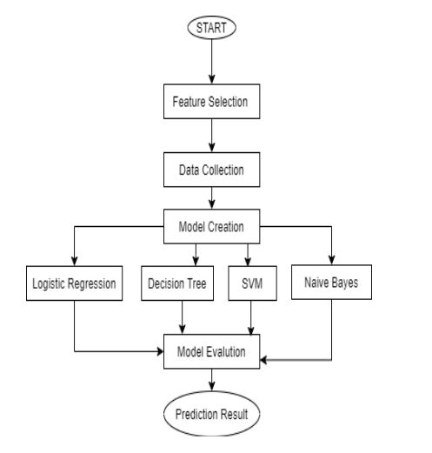
Flow chart of proposed model:

Slide 9
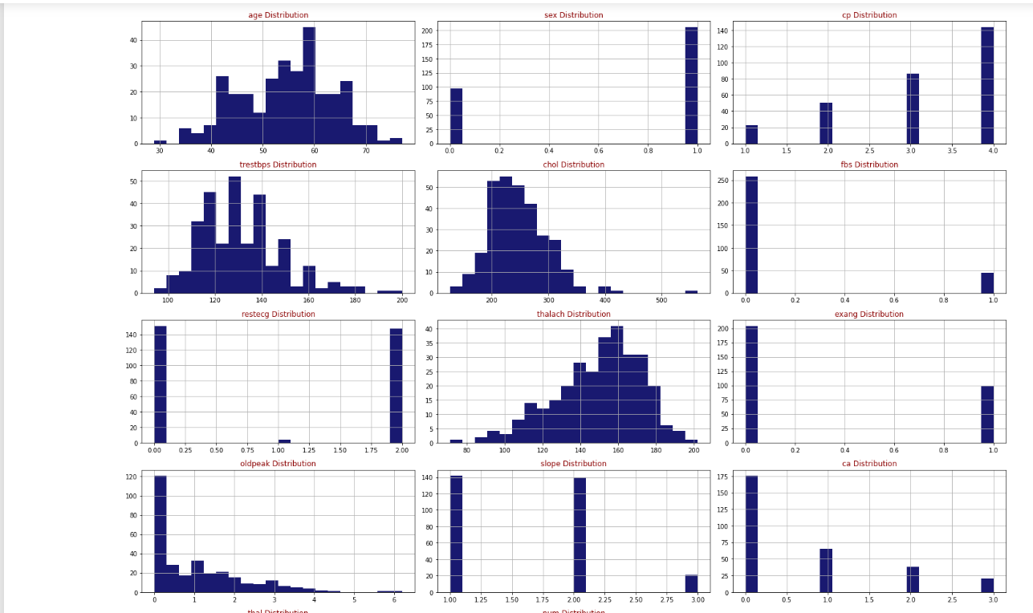
Results and simulations Data Visualisations

Slide 10
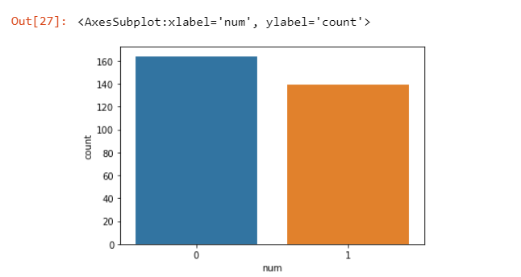
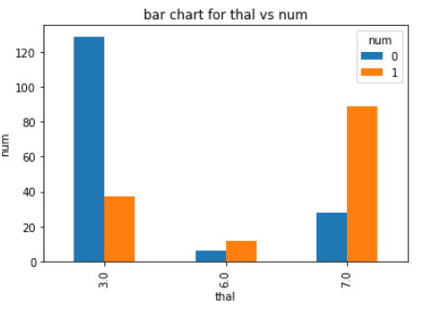
Graph Depicting Number of 0’s and 1’s in Dataset

Slide 11
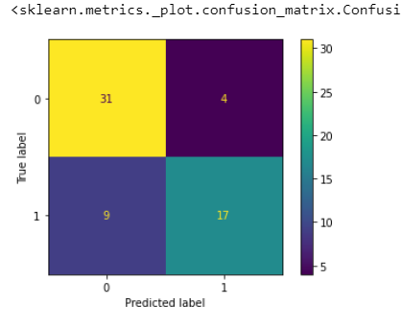
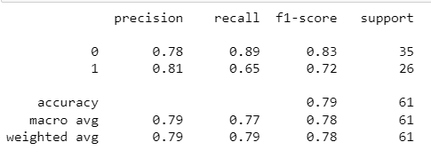
Logistic Regression
Classification Report
Confusion Matrix for Logistic Regression

Slide 12
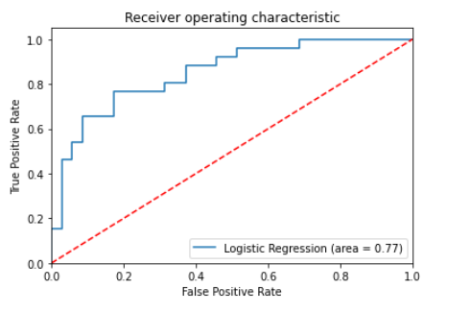
Roc Curve for logistic Regression

Slide 13
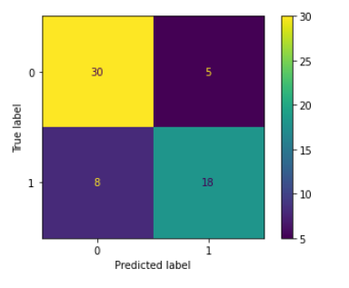
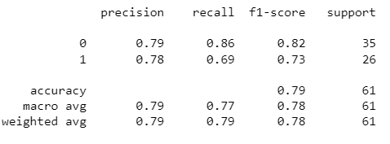
Naïve Bayes
Classification Report
Confusion Matrix for Naïve Bayes

Slide 14
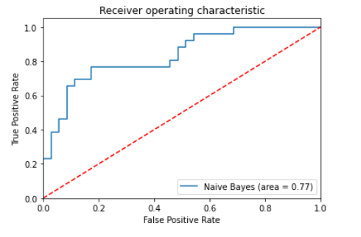
ROC Curve for Naïve Bayes

Slide 15
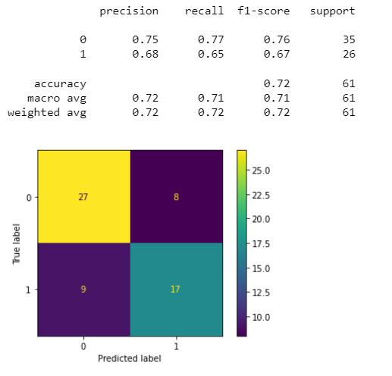
Decision Tree
Confusion matrix and classification report

Slide 16
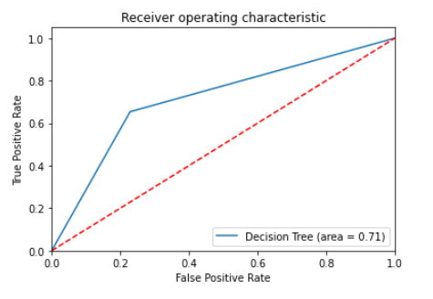
ROC Curve for Decision Tree

Slide 17
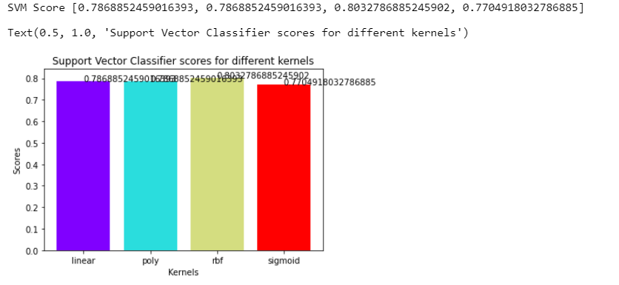
Support vector machine
Kernel Scores for Different Kernels

Slide 18
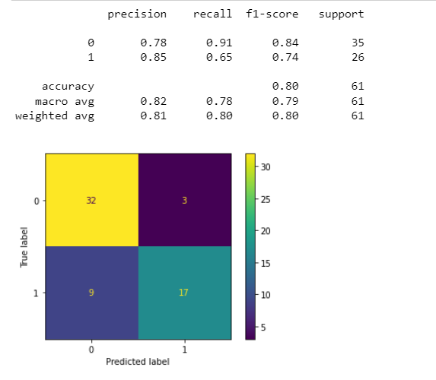
Confusion matrix and Classification Report for SVM

Slide 19
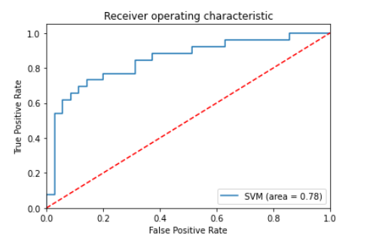
ROC Curve for SVM

Slide 20
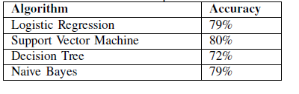
Comparison Of accuracies of different machine learning models

